Slide 1
Creational Patterns (1)
CS350/SE310 Fall 2015

Slide 2
Review
Software Design
  Mapping between problem domain to programming domain
    Data structure (Proper usage of date structure is critical!!)
    Interfaces
    Program Logic
Object Oriented Design
  Classes/Objects---Shift in responsibility
    Data structure: data members
    Interfaces
    Program Logic
  Abstraction
  Modularization
How you code reflects how you think

Slide 3
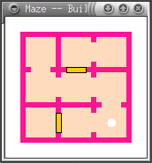
The Maze Game
Popular videogame
Centerpiece: a class that generates maze layouts
  creates random mazes to be solved
  different for every game
  MazeGame

Slide 4
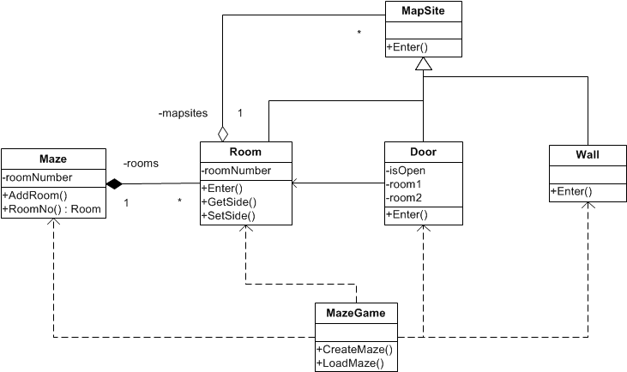
Maze creation process
Invoked for each game

Slide 5
Maze creation process
public class MazeGame {
public MazeGame() {...}
public Maze createMaze () {
Maze aMaze = new Maze();
Room r1 = new Room(0);
Room r2 = new Room(1);
Door theDoor = new Door(r1, r2);
aMaze.addRoom(r1);
aMaze.addRoom(r2);
r1.setSide(Direction.NORTH, new Wall());
r1.setSide(Direction.EAST, theDoor);
r1.setSide(Direction..SOUTH, new Wall());
r1.setSide(Direction.WEST, new Wall()); r2.setSide(Direction.NORTH, new Wall());
r2.setSide(Direction.EAST, new Wall());
r2.setSide(Direction.SOUTH, new Wall());
r2.setSide(Direction.EST, theDoor);
return aMaze;
}
// ...
}

Slide 6
Change: game extensions
New Features
  add new types of mazes to the game …
  … without changing the overall logic according to which the game works
  in particular how it creates the mazes
Example: besides regular mazes
  Add enchanted mazes
  Add bombed mazes
  … etc.

Slide 7
Solutions with current code
Duplicate code of createMaze()
  createEnchantedMaze()
  createBombedMaze()
Add switch/case statements every time a constructor is invoked
  based on some flag variable
…
Re-factor!
public class MazeGame {
public MazeGame() {...}
public Maze createMaze () {
Maze aMaze = new Maze();
Room r1 = new Room(0);
Room r2 = MakeRoom();
Door theDoor = new Door());
aMaze.addRoom(r1);
aMaze.addRoom(r2);
r1.setSide(MapSite.NORTH, new Wall());
r1.setSide(Direction.EAST, theDoor);
r1.setSide(Direction.SOUTH, new Wall());
r1.setSide(Direction.WEST, new Wall()); r2.setSide(Direction.NORTH, new Wall());
r2.setSide(Direction.EAST, new Wall());
r2.setSide(Direction.SOUTH, new Wall());
r2.setSide(Direction.WEST, theDoor);
return aMaze;
}
// ...
}
Notes:
Sol 1 requires also changing the client invoking the createMaze() method
Sol. 2 needs to be re-written every time a new extension comes out - again error-prone

Slide 8
Object creation patterns

Slide 9
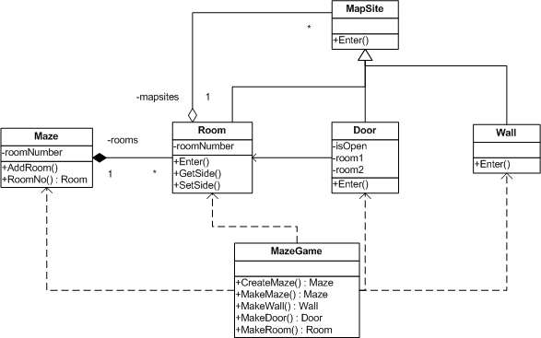
Refactoring maze creation
Client still invokes this method
Factory Methods

Slide 10
Factory methods
Each of the factory methods wraps the invocation of corresponding constructor
A set of methods that can be inherited and overridden
Examples (See Code):
  Room makeRoom(int id) {
  return new Room(id);
  }
  Wall makeWall() {
  return new Wall();
  }

Slide 11
Creating the maze
public class MazeGame {
public MazeGame() {...}
public Maze createMaze ( ) {
Maze aMaze = mf. MakeMaze();
Room r1 = MakeRoom(0);
Room r2 = MakeRoom(1);
Door theDoor = MakeDoor(r1, r2);
aMaze.addRoom(r1);
aMaze.addRoom(r2);
r1.setSide(Direction.NORTH, MakeWall());
r1.setSide(Direction.EAST, theDoor);
r1.setSide(Direction.SOUTH, MakeWall());
r1.setSide(Direction.WEST, MakeWall()); r2.setSide(Direction.NORTH, MakeWall());
r2.setSide(Direction.EAST, MakeWall());
r2.setSide(Direction.SOUTH, MakeWall());
r2.setSide(Direction.WEST, theDoor);
return aMaze;
}
// ...
}

Slide 12
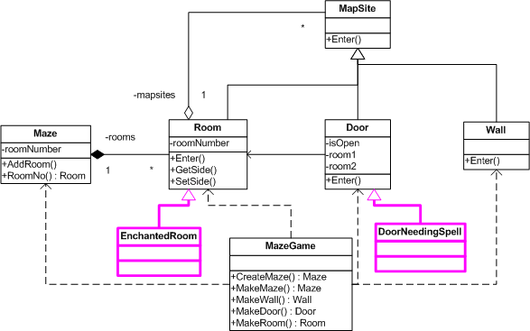
Build Enchanted Products

Slide 13
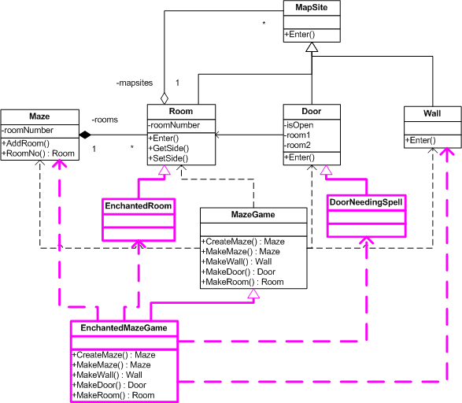
Enchanted Maze Creator
createMaze()
can still be invoked to create regular mazes or enchanted mazes without modification

Slide 14
Enchanted Maze Creator
public class EnchantedMazeGame extends MazeGame {
public Room makeRoom(int n) {
return new EnchantedRoom(n);}
public Wall makeWall() {
return new EnchantedWall();}
public Door makeDoor(Room r1, Room r2) {
return new EnchantedDoor(r1, r2);}
}

Slide 15
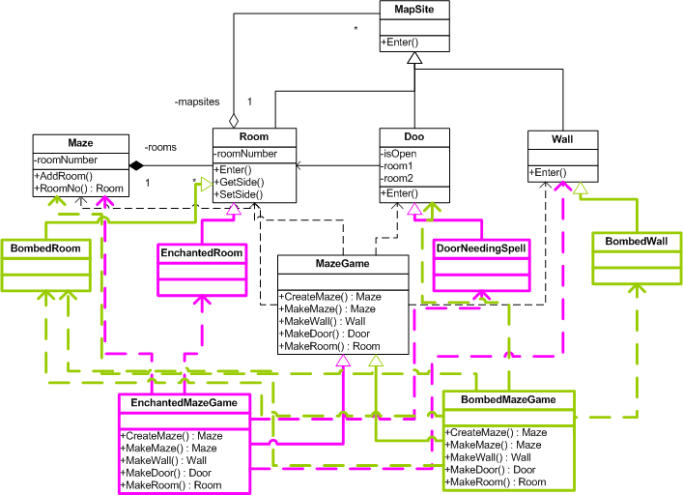
Build Bombed Mazes

Slide 16
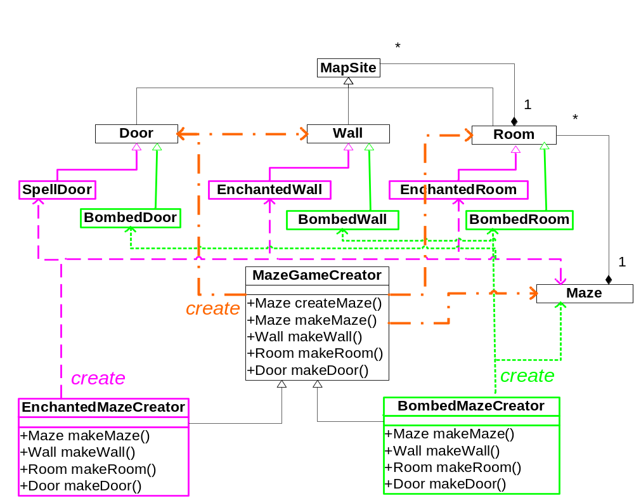
Build Bombed Mazes

Slide 17
Properties of this solution
The client component in the game that invokes the creation of mazes does not need to change
It interacts with different mazes creator classes
  Depending on the parameters provided by the player
  in exactly the same way as in the original game
Caveat:
  Recall we need a “global” flag that tells us which MazeCreator subclass we need to instantiate in every game

Slide 18
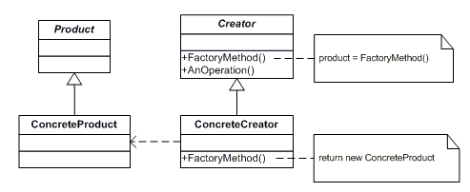
The Factory Method pattern
- structure

Slide 19
Advantages
The Creator provides a factory method that substitute constructor of ConcreteProducts
  The business logic of product creation, initialization etc. can be wholly encapsulated in those methods
The client of Creator can ask for the production of different Products in a uniform way
  And use them uniformly (all derive from main Product super-class)
  Without needing to know the nitty-gritty details

Slide 20
The Factory Method pattern
Classification:
  Creational purpose; Class scope
Context: dynamic creation of different types of objects depending on context, transparent the client
Problem: a client class needs to instantiate one of many derivations of another class, but does not know which one.
Solution: define an interface for creation, and delegate to a derived class of that interface the decision of what class to instantiate and how
Consequences:
  Need for parallel Product/Creator hierarchies
  The logic of creating a particular types of product is encapsulated in each Creator

Slide 21
Factory Method in the real world
Example:
iterator() in Java Collections
Depending on the Collection type being used, it returns the right iterator object
  which implements the right traversal algorithm for that Collection

Slide 22
Creational patterns
Abstract object instantiation
Add one more level of abstraction on top of OO languages
What’s the use of the extra abstraction layer?

Slide 23
Creational patterns - motivation
Evolution and extendibility of the system
Do not hardcode object creation
  Type selection is static when using constructor
  Prepare for more types of similar objects to enter the design
The extra layer of abstraction enables to configure the system dynamically
  Depending on the configuration, the system will create those new types

Slide 24
Analogy: factory
Imagine a company with many different products in the same product family
  and 1 production plant: a factory
The more flexible the plant, the more successful the company’s business!

Slide 25
Analogy: factory
You want the capability of making different products in the same production plant
  Simply by hitting a switch
The production procedure followed by the factory is the same
  independent from the product being produced
  the switch controls what machinery is activated during the production process
Result: a different final product

Slide 26
Another creational pattern
Abstract Factory
  Similar to Factory method
  Separate concerns further
Let’s see the difference in our Maze game example …

Slide 27
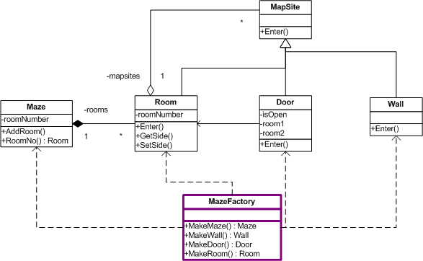
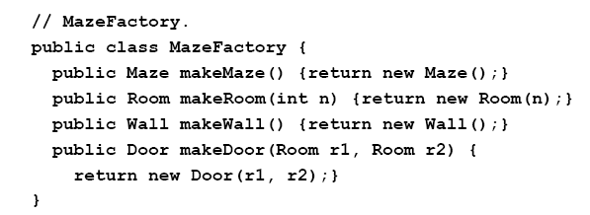
MazeGame Abstract Factory

Slide 28
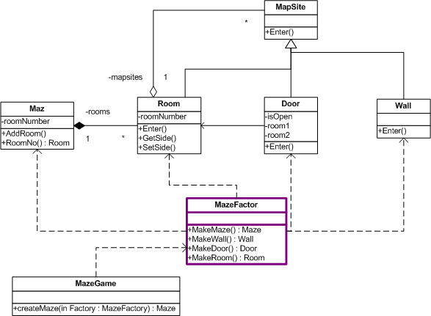
MazeGame Abstract Factory
The createMaze() now takes a MazeFactory reference as a parameter

Slide 29
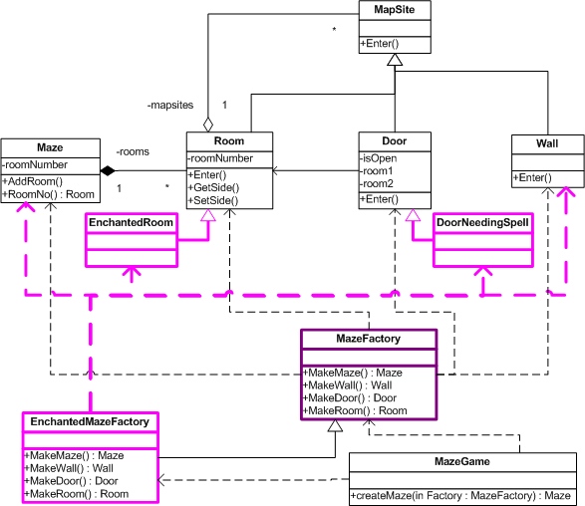
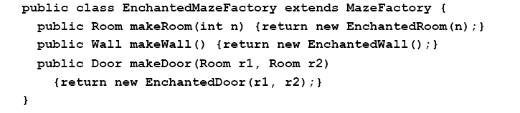
Enchanted
Feature

Slide 30
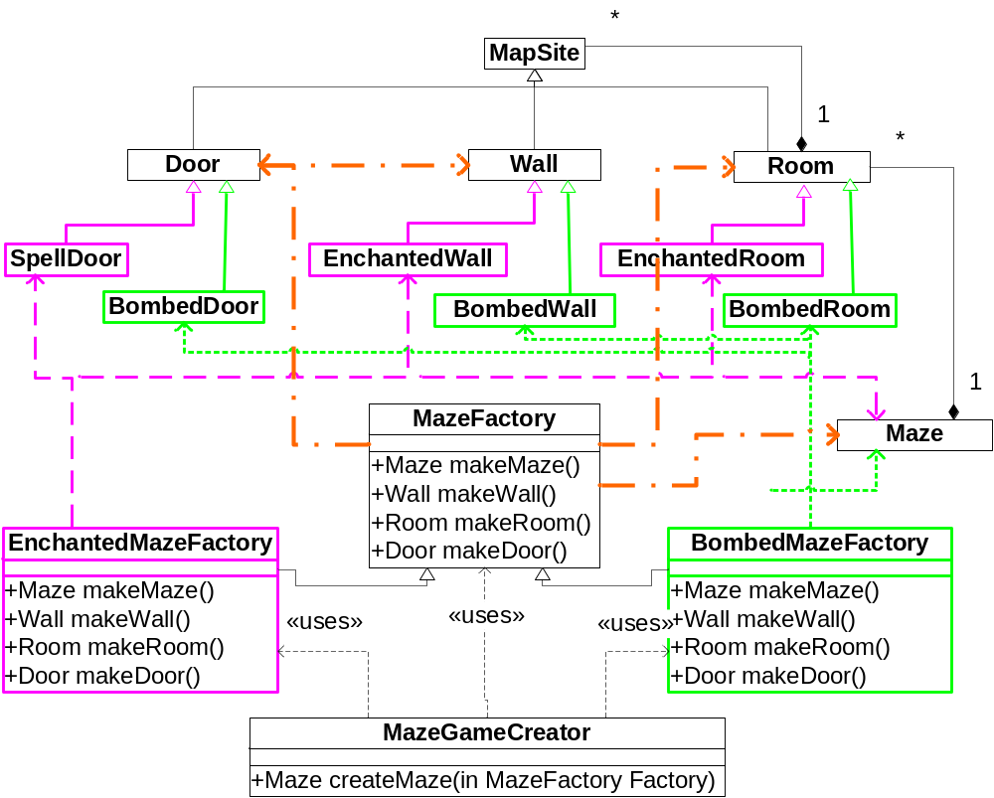
Bombed Feature

Slide 31
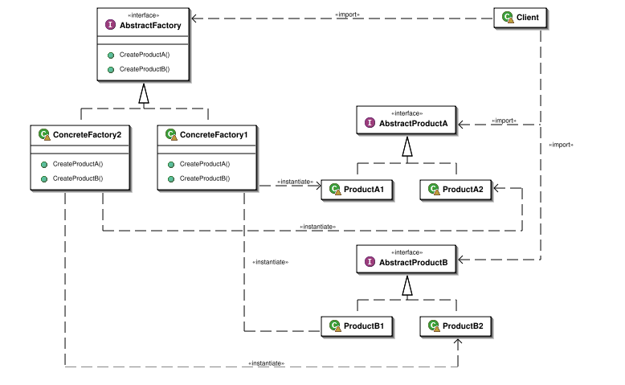
Abstract Factory - structure

Slide 32
Dependency Inversion Principle

Slide 33
Abstract Factory vs. Factory Method
Slightly more elegant than Factory Method in our example
Where is the difference?
In fact, very similar to the Factory Method pattern
  in Abstract Factory, a class delegates the responsibility of object instantiation to another one via composition
  the Factory Method pattern uses inheritance to handle the desired object instantiation.

Slide 34
When to use Abstract Factory Pattern
When a system should be independent of how its products are created, composed, and represented
When a class can't anticipate the class of objects it must create
When a system must use just one of a multiple families of product objects
When a family of related product objects is designed to be used together, and you need to enforce this constraint

Slide 35
The Abstract Factory pattern
Classification:
  Creational purpose; Class scope
Context: there are multiple libraries or sets of classes that are to be chosen depending on context
Problem: families of related objects need to be instantiated together
Solution: coordinates the creation of objects of the same family. Client remains agnostic on the procedure and the rules about which object is in which family
Consequences:
  The logic of creating a particular object family is kept hidden from client
  Enforces family rules
  Supporting new prduc requires changing the AbstractFactory interface

Slide 36
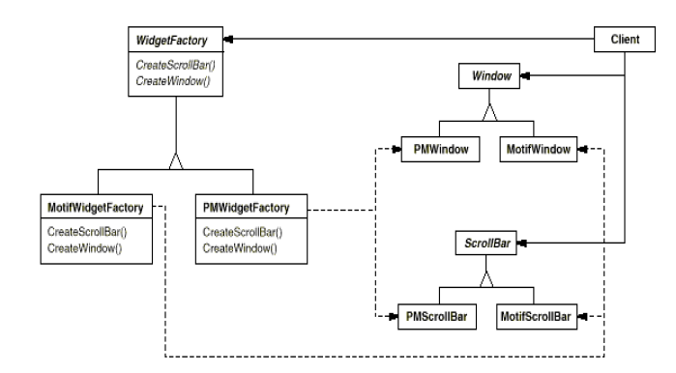
Real-world example: A GUI toolkit that supports multiple look-and-feels

Slide 37
The Abstract Factory Pattern provides an interface for creating families of related or dependent objects without specifying their concrete classes.
The Factory Method Pattern defines an interface for creating an object, but let subclasses decide which class to instantiate. Factory method lets a class defer instantiation to the subclasses

Slide 38
Bullet Points
All factories encapsulate object creation
Factory Method relies on inheritance: object creation is delegated to subclasses which implement the factory method to create objects
All factory patterns promote loose coupling by reducing the dependency of your application on concrete classes

Slide 39
Bullet Points
The intent of Factory Method is to allow a class to defer instantiation to its subclasses
The intent of Abstract Factory is to create families of related objects without having to depend on their concrete classes.

Slide 40
Class recap
Creational patterns
  Factory method
  Abstract Factory

Slide 41
(SOLID) Design Principles
Single Responsibility (Separation of Concern)
Open Close Principle
Liskov Substitution Principle
Interface Segregation Principle
Dependency Inversion Principle (Information Hiding, Favor composition over inheritance)

